Slide 1
Recommendation systems

Slide 2
Agenda
Why recommendation systems?
Real world examples and historical trends
Basic techniques of recommendation
Popularity based
Classification
Content based
Collaborative filtering
Hybrid approaches
Evaluation of recommendation
Python examples
Advances in recommendation systems

Slide 3

We are overloaded
Thousands of news articles and news blogs each day
Millions of movies, books, music tracks
online
Several thousands of ad messages sent to us each day
But is it new topic?
what is new?

Slide 4
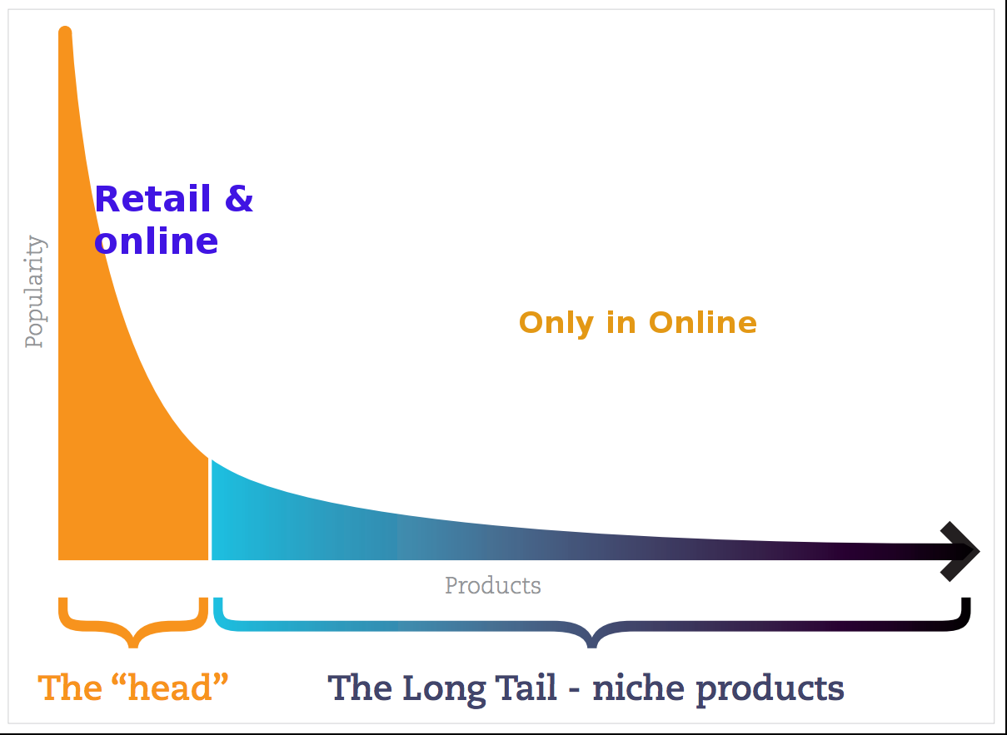
From scarcity to abundance
Limited resources:
Shelf space
No of hours for TV shows
No of theaters for Movies
Web enabled near-zero-cost dissimination of information about products
Reliance vs Amazon
long tail phenomenon
Cut off point
Area of the curve
http://dataaspirant.com/2015/05/25/collaborative-filtering-recommendation-engine-implementation-in-python/

Slide 5
Why Recommendation System?
What we can solve?
Help user find item of their interest.
Help item provider deliver their items to right user.
Identify products most relevant to the user
Personalized content
Eg. Top n offers
Help website improve user engagement.
Recommender system creates a matching between users and items and exploits the similarity between users/items to make recommendations.

Slide 6
What can be recommended?
Advertising messages Movies
Books Music tracks
News articles
Restaurants
Future friends (Social network sites) Courses in e-learning
Jobs
Research papers Investment choices TV programs Citations
Cloths
Online mates (Dating services) Supermarket goods

Slide 7
User and matching items
Amazon Users: members, Items: products, e.g., books Netflix Users: members, Items: movies, TV shows LinkedIn Users: members, Items: members Facebook Users: members, Items: jobs
Power of Recommendations*:
Netflix: – 2/3 rented movies are from recommendation
Google News – 38% more click-through are due to recommendation Amazon – 35% sales are from recommendation
*(Celma & Lamere, ISMIR 2007)

Slide 8


Recommendation historical trends
In 1988, a British mountain climber named Joe Simpson wrote a book called Touching the Void, a harrowing account of near death in the Peruvian Andes. It got good reviews, only a modest success, it was soon forgotten. Then, a decade later, a strange thing happened. Jon Krakauer wrote Into Thin Air, another book about a mountain-climbing tragedy, which became a publishing sensation. Suddently, Touching the Void started to sell again.”...The Long Tail by Chris Anderson
Published in 1988
Published in 1996
https://www.wired.com/2004/10/tail/

Slide 9
Real world examples
GroupLens(https://grouplens.org/)
Helped in development of initial recommender systems by pioneering initial collaborative filtering models
Provided various datasets –MovieLens and BookLens
•Amazon –Did lot of work on implementing commercial recommender systems
They also implemented lot of computational improvements
•Netflix Prize
Pioneered Latent Factor/Matrix Factorization models
•Google –You Tube
Hybrid recommendation systems
Deep Learning Based Systems
•Social Network Recommendations

Slide 10



Perfect matching item may not exist
Product #1
I want a laptop with 500GB HD, 8GB memory and i5 processor for ₹ 25,000
HD: 500 GB
Memory: 8 GB
Processor: i7
Price: ₹ 35,000
Product #3
Product #2
HD: 250 GB
Memory: 6 GB
Processor: i5
Price: ₹ 30,000
HD: 250 GB
Memory: 4 GB
Processor: i3
Price: ₹ 23,000

Slide 11
Types of recommendation systems
Popularity based recommendations
Classification model based
Content based recommendations
Nearest neighbour collaborative filtering:
User based
Item based
Hybrid approches
Association rule mining
Deep learning based recommendation system

Slide 12
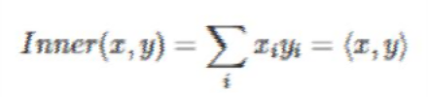
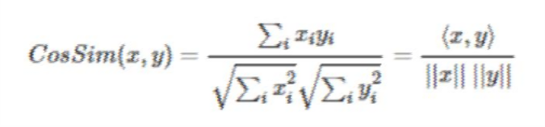
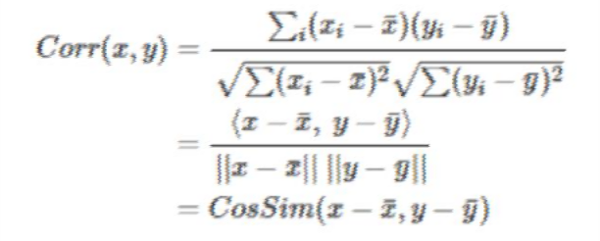
Fundamental concepts of similarity
Euclidean Distance Cosine Similarity:
Similarity is the cosine of the angle between the 2
vectors of the item vectors of A and B
Closer the vectors, smaller will be the angle and larger the cosine.
Pearson Similarity:
Similarity is the pearson coefficient between the
two vectors.
Pearson correlation and cosine similarity are invariant to scaling.
Cosine similarity is NOT invariant to shifts. Pearson correlation is invariant to shifts.
Correlation is the cosine similarity between centered versions of x and y & between -1 to 1

Slide 13
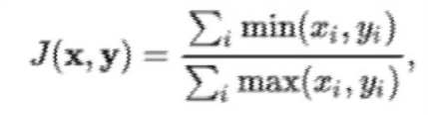
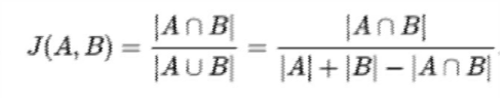
Fundamentals
Jaccard Similarity:
Similarity is based on the number of users which have rated item A and B divided by the number of users who have rated either A or B
Intersection over Union
It is used for comparing the similarity and diversity of sample sets
If x,y are two vectors with all real xi, yi then jaccardian similarity coefficient:
The Jaccard distance, which measures dissimilarity between sample sets, is complementary to the Jaccard coefficient and is obtained by subtracting the Jaccard coefficient from 1

Slide 14
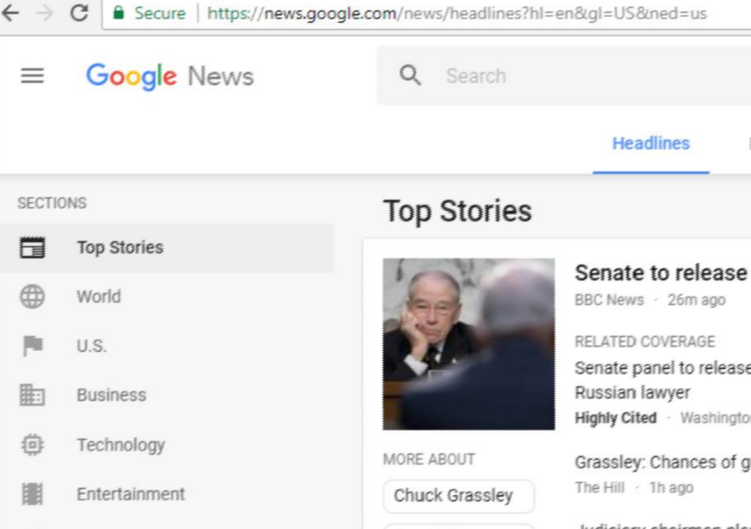
Popularity based Recommender System
Recommend items viewed/purchased by most people
Recommendations: Ranked list of items by their purchase count / viewed count
“Popular News” It uses:
Can use context
Purchase history
User and item features
Scalale
Not a personalized recommendation

Slide 15


Classification model
Use features of both products as well as users in order to predict whether a user will like a product or not.
Limitations.
User Features (Eg. Age, Gender)
Product Features (Eg. cost, quality)
Purchase History
It is difficult to collect high quality information about products and users.
Even if they collect, they may not be sufficient to make a good classifier
Scalability issue
Classifier
Like/Not
like
The outcome can be 1 if the user likes it or 0 otherwise
Incorporates personalization

Slide 16
Content based recommendations
Recommendations are based on information on the content of items rather than on other users’ opinions.
Main idea:
If you like an item then you will also like a “similar” item
Based on similarity of the items being recommended:
Recommend items to customer x similar to previous items rated highly by x
Uses a machine learning algorithm to induce a profile of the users preferences from examples based on a featural description of content.
No need for data on other users.
No cold-start or sparsity problems.
Able to recommend to users with unique tastes.
Techniques that can be used: Cosine similarity

Slide 17
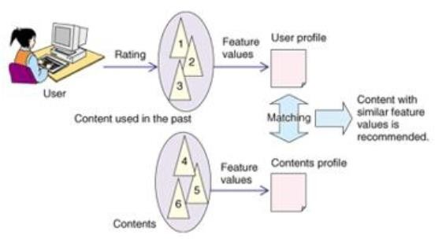
Content based recommendation system
Item Profiles:
set of features
vector
User profiles:
Weighted average of rated item profiles
Normalize rating using average rating of
user

Slide 18
Content based recommendation system
Advantages
Content-based recommender systems don’t require a lot of user data.
We just need item data and you’re able to start giving recommendations to users.
Recommendation engine does not depend on lots of user data, so it is possible to give recommendations to even your first customer as long as you have adequate data to build his user profile. Does not suffer from cold start
Less expensive to build and maintain
Challenges
Your item data needs to be well distributed
Availability of features which explain Items and user preferences
Recommendations will likely be direct substitutes, and not complements, of the item the user interacted with. This is one of the key reasons why collaborative filtering provides better recommendations
Less dynamic

Slide 19
Collaborative Filtering
Idea: If a person A likes items 1, 2, 3 and B like 2,3,4 then they have similar interests and A should like item 4 and B should like item 1.
This algorithm is entirely based on the past behavior and not on the context.
This makes it one of the most commonly used algorithm as it is not dependent on any additional
information.
Basic assumptions:
Customers who had similar tastes in the past, will have similar tastes in the future
Users give ratings to catalog items (implicitly or explicitly)
Examples:
Product recommendations by e-commerce player like Amazon and merchant recommendations by banks like American Express.
User-User Collaborative filtering Item-Item Collaborative filtering

Slide 20
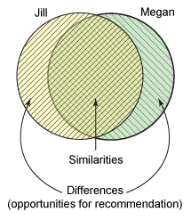
Collaborative Filtering
Recommend this difference to Megan
Recommend this
difference to Jill

Slide 21
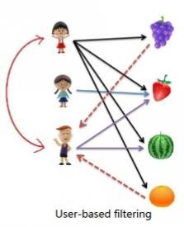
User based nearest neighbour Collaborative filtering
Find users who have a similar taste of products as the current user.
Similarity is based upon similarity in users’ purchasing behaviour.
“User x is similar to user y because both purchased items A, B and C.”
Memory-based: the rating matrix is directly used to find neighbors / make predictions
Does not scale for most real-world scenarios
http://www.salemmarafi.com/code/collaborative-filtering-with-python/

Slide 22
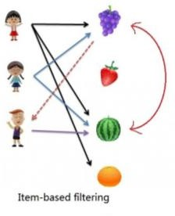
Item based nearest-neighbour collaborative filtering
Recommend items that are similar to the items the user bought.
Similarity is based upon co-occurence of purchases:
Use the similarity between items (and not users) to make predictions
“Items A and B were purchased by both users x and y, so they are similar.”
item-based CF is an example for model-based approaches

Slide 23
Intuition behind CF
 | Finding Nemo | Toy Story | Exorcist | Conjuring | The Terminal | Forrest Gump
User 1 | 5 | 4 |  | 2
User 2 |  |  | 4 | 4 |  | 3
User 3 |  | 2 |  |  | 5 | 4
User 4 | 4 | 5 | 3
User 5 |  |  | 5 | 5 | 3
User 6 | 4 | 4 |  | 2
“Finding Nemo” and “Toy Story” seem to be related since users who have rated both these movies have rated them highly

Slide 24
How do we compute Similarity – 1/2
Pearson Similarity
Similarity is the Pearson coefficient between the two vectors
Cosine Similarity
Similarity is the cosine of the angle between the 2 item vectors
Cosine Similarity
Pearson Similarity
Correlation is the cosine similarity between centered versions of x and y

Slide 25
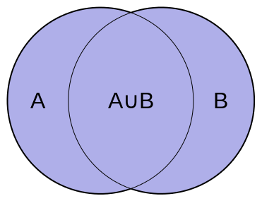
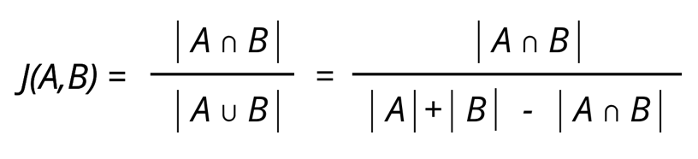
How do we compute Similarity – 2/2
Jaccard Similarity is useful when the User/Item Matrix contain binary values (e.g. did the user watch the movie or not)

Slide 26
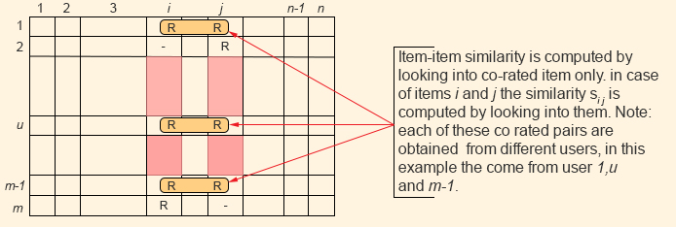
Item based CF
Recommend items that are similar to the items the user has already purchased (or viewed/interacted with)
Similarity is computed between any 2 pairs of items by looking into co-rated items only (using any of the similarity measures described before)
Image Source* : http://www.cs.carleton.edu/cs_comps/0607/recommend/recommender/itembased.html

Slide 27
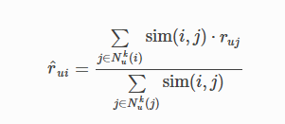
Item based CF How to generate recommendations using IBCF
IBCF Formula
Explanation: To determine the preference of a given user, say u_1, to a given item say i_12, we perform the following steps:
From the Item-Item Similarity Matrix, identify the Top K most similar items to item, i_12
Let’s assume the items are (with K=5) : i_4, i_13, i_21, i_32, i_43
From the list of similar items, find the items already rated by the user u_1 – Say, the user has rated i_4 and i_32 as 4 and 5 respectively
Similarity between i_12 and i_4 and i_12 and i_32 is 0.7 and 0.9 respectively
The estimated rating that u_1 will give to i_12 is then
(4*0.7 + 5*0.9)/(0.7 + 0.9) = 4.56

Slide 28
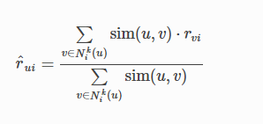
User based CF
Instead of finding similarity between items (columns, in the User-Item matrix), similarity between Users (rows) is considered
Explanation: To determine the preference of a given user, say u_1, to a given item say i_12, we perform the following steps:
From the User-User Similarity Matrix, identify the Top K most similar items to User, u_1
Let’s assume the users are (with K=5) : u_10, u_22, u_67, u_72, u_89
From the list of similar users, find the users who have rated the item i_12 – Say, the users u_10 & u_72 have rated i_12 (rating 4 & 3 respectively). Similarity between u_1 and u_10 and u_1 and u_72 is 0.7 and 0.9 respectively
The estimated rating that u_1 will give to i_12 is then
(4*0.7 + 3*0.9)/(0.7 + 0.9) = 3.43

Slide 29
IBCF vs UBCF
IBCF is more efficient than UBCF
Typical applications involve far more Users than Items. Hence Similarity matrix for IBCF is more compact than UBCF
Similarity estimates between items is also more likely to converge over time than similarity between users. Hence the similarities can be pre-computed and cached unlike similarity between users that need to be dynamically computed
However, the IBCF recommendations tend to be more conservative than UBCF

Slide 30
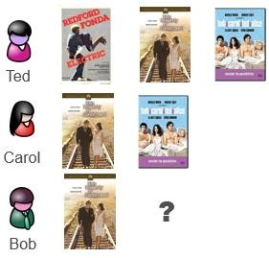
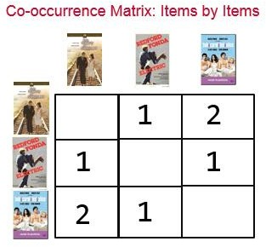
Item based collaborative filtering: Example
History Matrix
B
A
C
A B C
A
A
C
B
A
C
Bob’s Recommendations= [C, B] https://www.mapr.com/blog/inside-look-at-components-of-recommendation-engine

Slide 31

Effect of popular items in item based collaborative filtering
B
A
C
A B C
A
A
C
100,000
B
A
C
If everybody has watched Titanic, then it is not a very good indicator of what to recommend next, then the recommender would become similar to a popularity based recommender engine.

Slide 32
Normalize co-occurance matrix
Normalize by Popularity
Jaccard similarity
-Number of users common for i and j
Number of users for either i or j
A
B
C
A
100,000
3
3
100,003
B
3
2
C
3
2

Slide 33


Effect of multiple items
Rows from normalized co-occurence matrix
B
A
C
A B C D
A
D
0 | 0.33 | 1 | 0.5
0.25 | 0.25 | 0 | 0.2
A
C
Weighted sum= (Scores for movie A
0.125 | 0.29 | 0.5 | 0.35
A
D
+ Scores for movie D)/2
C
D
B
A
Ranked
Recommendations:
0.5 | 0.35 | 0.29 | 0.125

Slide 34
Collaborative filtering: Complexity
Expensive step:
Finding k most similar users or items O (|U|) where U is the size of utility matrix
Item -> compute similarity wrt every other item Better not to do at run time
Can we precompute?
Simple pre-computation for ‘n’ items: O(n.|U|)
Techniques like dimensionality reduction or clustering or near neighborhood search algorithms can be used.

Slide 35
Strengths of Collaborative Filtering
Content-Agnostic
Does not require items or users to be tagged with content information
Recommendations are very personalized because they’re based on like-minded people
Adaptive to the user base
Can pick up on fitting recommendations that would be difficult or impossible to identify with a
content-based method
Inherently adaptive to preference changes over time

Slide 36
Issues with collaborative filtering
Cold Start: There needs to be enough other users already in the system to find a match.
In recommender systems, the cold start problem is often reduced by adopting a hybrid approach
between content-based matching and collaborative filtering.
Sparsity: If there are many items to be recommended, even if there are many users, the user/ratings matrix is sparse, and it is hard to find users that have rated the same items.
Systems unable to compute ratings for a large number of items since very few user preferences available
Unable to find similarities between users due to sparse representation available
Hybrid approaches help where content on users/items is used to improve predictions
Grey Sheep
Users for whom recommendations can not be made because of sparsity problem

Slide 37
Issues with collaborative filtering
Popularity Bias: Cannot recommend items to someone with unique tastes.
Tends to recommend popular items.
Recommender systems may only recommend popular items due to more data being available on them and may introduce a positive feedback loop not allowing more relevant items with less popularity
Shilling attacks
Users creating fake preferences to push their own items
Scalability
Collaborative filtering can be very computationally expensive
Distributed frameworks have been heavily used with organizations like Amazon, Facebook and LinkedIn developing their own engineering solutions to handle this

Slide 38
Comparision of methods for songs
Last.fm creates a "station" of recommended songs by observing what bands and individual tracks the user has listened to on a regular basis and comparing those against the listening behavior of other users.
Pandora uses the properties of a song or artist (a subset of the 400 attributes provided by the Music Genome Project) to seed a "station" that plays music with similar properties.
User feedback is used to refine the station's results, deemphasizing certain attributes when a user "dislikes" a particular song and
Last.fm will play tracks that do not appear in the user's library, but are often played by other users with similar interests.
emphasizing other attributes when a user
As this approach leverages the behavior of users, it is an "likes" a song.
example of a collaborative filtering technique.
Last.fm requires a large amount of information about a user to make accurate recommendations. This is an example of the cold start problem, and is common in collaborative filtering systems.
This is an example of a content-based approach.
Pandora needs very little information to start, it is far more limited in scope

Slide 39
Performance metrics
RMSE
MAE –Mean Absolute Error
Accuracy
ROC curve
Precision
Recall
Precision Recall Curve: Evaluation of top n recommendations

Slide 40


Evaluation measures
Out of all the recommended items, how many the user actually liked? What ratio of items that a user likes were actually recommended.
Precision: Out of all items retrieved, how many are relevant
It is based on true positives and false positives.
It shows how many selected items are actually also relevant.
True positives (TP) are the positive guesses made that were actually correct while the false positives (FP) are the positive guesses made that were incorrect.
Recall: How many relevant items retrieved from all relevant items
is based on true positives and false negatives.
It shows how many of the relevant information is selected.
The true positives (TP) are again the positive guesses made that were actually correct while the false
negatives (FN) are negative guesses while they should have been positive.
33

Slide 41

Evaluation measures
Accuracy: Percentage guessed correct from total guesses
method that is based on exact matches.
This is the most simple evaluation method, but may perform poorly based on the data.
If the labels of your data mostly consist of one specific cluster, the classifiers may classify all the data as that cluster. Since the data contains mostly that cluster, its accuracy will be high due to one classification.
This may cause promising results, but they are not correct. So for this measure, it is necessary to have information about the labels of your data. The number itself is not enough for performance conclusions.
34

Slide 42
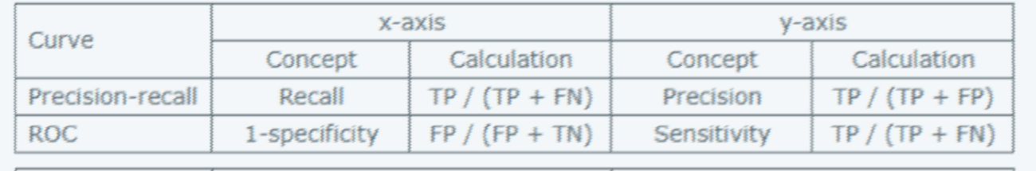
RoC and Precision Recall curve
Receiver operating characteristics curve.
A plot of true positive fraction (= sensitivity) vs. false positive fraction (= 1 – specificity) for all potential cut-offs for a test.
A ROC curve plots recall (true positive rate) against fallout (false positive rate) for increasing recommendation set size.
In Top-20 recommender example,
The 20 items you recommend for a user are the Positive items, and the unrecommended items are Negative.
Precision Recall Curve:
A precision-recall curve shows the relationship between precision (= positive predictive value) and recall (= sensitivity) for every possible cut-off.
The main difference between ROC curves and precision-recall curves is that the number of true-negative results is not used for making a PRC.

Slide 43
Hybrid recommender systems
Multiple recommender systems are combined to improve recommendations
•Although any type of recommender systems can be combined a common approach in industry
is to combine content based approaches and collaborative filtering approaches
•Content based models can be used to solve the Cold Start and Gray Sheep problems in Collaborative Filtering
•Some of the typical methods of Hybridization include
Weighted –Recommendations from each system is weighted to calculate final recommendation
Switching –System switches between different recommendation model
Mixed - Recommendations from different recommenders are presented together
A common approach is to use Latent Factor models for high level recommendation and then
improving them using content based systems by using information on users or items

Slide 44
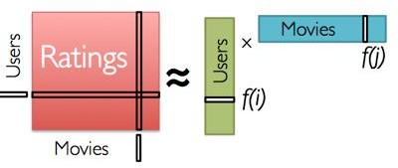
Model based collaborative filtering
Identify latent (hidden) features from the input user x itemRatings matrix to represent users and items as vectors in N dimensional space.
Matrix factorization
Generate low-rank approximation of matrix
Detection of latent factors
Projecting items and users in the same n-
dimensional space
Use Matrix factorization approaches (Eg. Singular value Decomposition or SVD) to split the Rating Matrix into constituent User Matrix and Item Matrix with minimum Sum of squared error (SSE).
Goal: Predict unknown ratings for the remaining set of movies using the learned User Matrix and Item Matrix

Slide 45
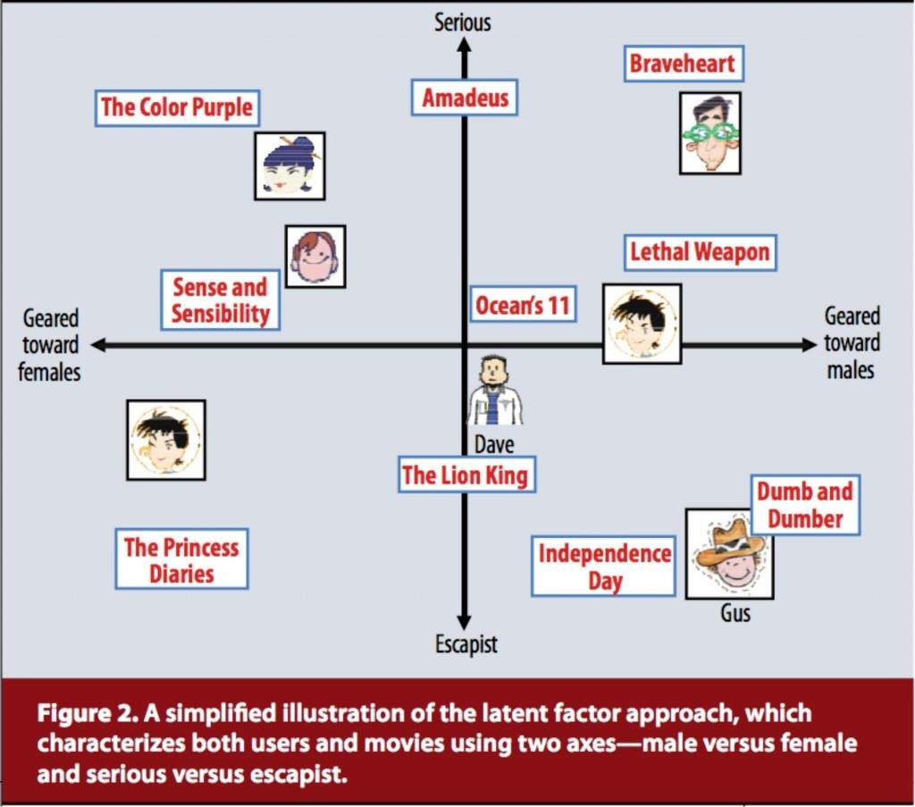

Model based Collaborative Filtering (Matrix Factorization)
Identify latent (hidden) features from the input user x itemRatings matrix to represent users and items as vectors in N dimensional space.
Koren, Yehuda, Robert Bell and Chris Volinsky. 2009. “Matrix Factorization Techniques for Recommender Systems.” Computer 42:8.

Slide 46
Industry example of e-commerce
Events:-
Tracks and stores on all consumer activity and behavior
Each click on product, adding to wishlist, adding to cart, save for later and purchase
Ratings:-
Assign implicit values on user actions
Ratings of products from the users
And Feedback
Filtering:-
Hybrid approach of Collaborative filtering and content based filtering

Slide 47
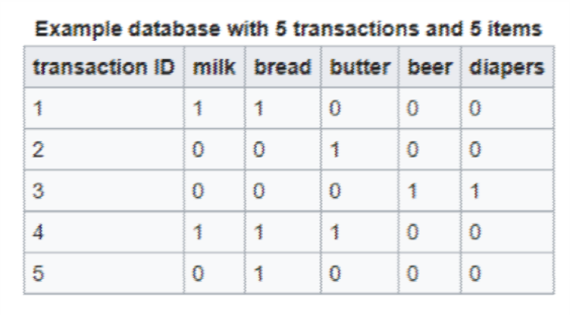

Association rule mining
Rules of the form x -> Y
from a set of sale transactions.
It's common use in shopping behaviour analysis
Can be used as the basis for decisions about marketing activities such as, e.g., promotional pricing or product placements.
It is NOT sequence mining: Association rule learning typically does not consider the order of items either within a transaction or across transactions.

Slide 48
Market basket analysis
Discovers co-occurrence relationships among activities performed. Market basket analysis can be used to divide customers into groups
Market basket analysis may provide the retailer with information to understand the purchase behavior of a buyer.
“customers who bought book A also bought book B”
When one super market chain discovered in its analysis that male customers that bought diapers often bought beer as well, have put the diapers close to beer coolers, and their sales increased dramatically.
Might tell a retailer that customers often purchase shampoo and conditioner together, so putting both items on promotion at the same time would not create a significant increase in revenue, while a promotion involving just one of the items would likely drive sales of the other.

Slide 49
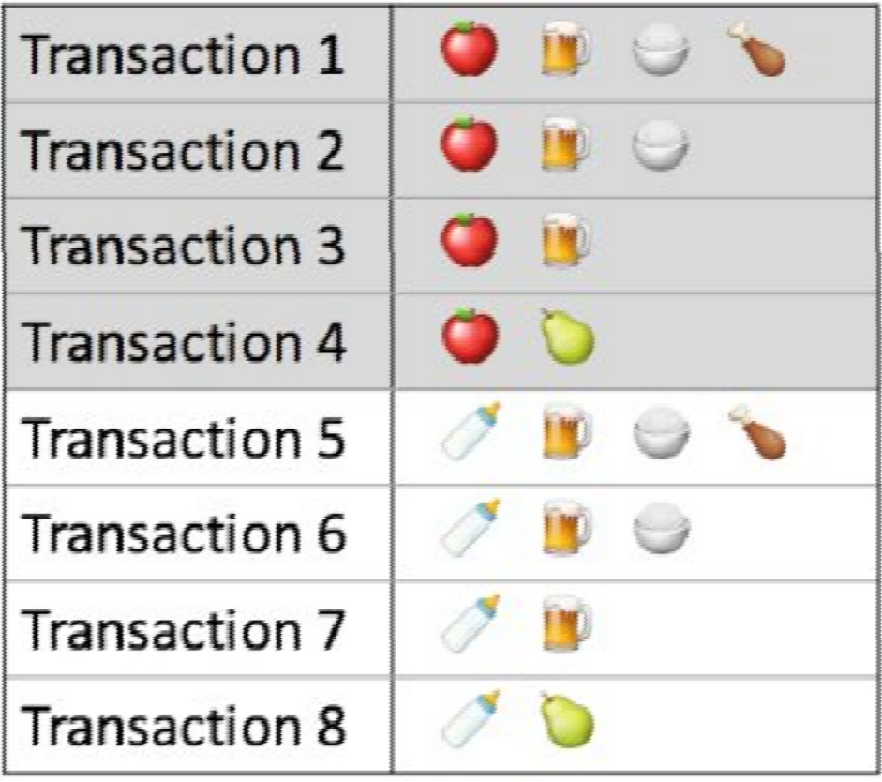
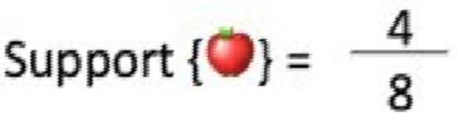
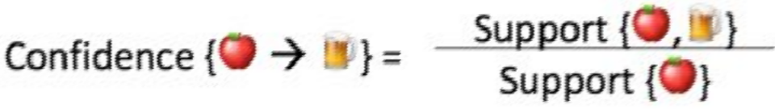
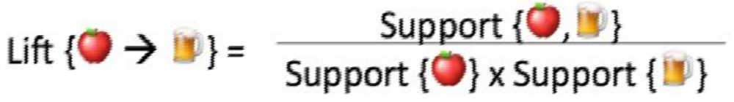
Apriori
Support refers to the default popularity of an item
Confidence refers to the likelihood that an item B is also bought if item A is bought
Lift(A -> B) refers to the increase in the ratio of sale of B when A is sold

Slide 50
Other recommender systems
Deep Neural Network for recommendation systems:
•YouTube recommendation system is based on Deep Learning, one of the largest and
most complex recommendation system
https://static.googleusercontent.com/media/research.google.com/en//pubs/archive/45530.pdf

Slide 51
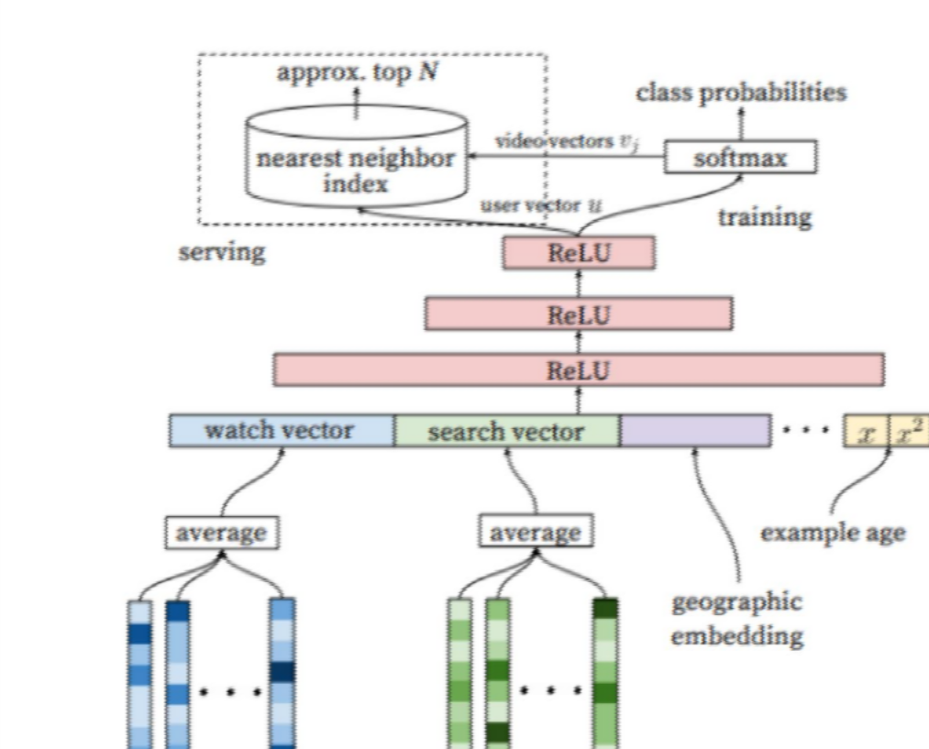
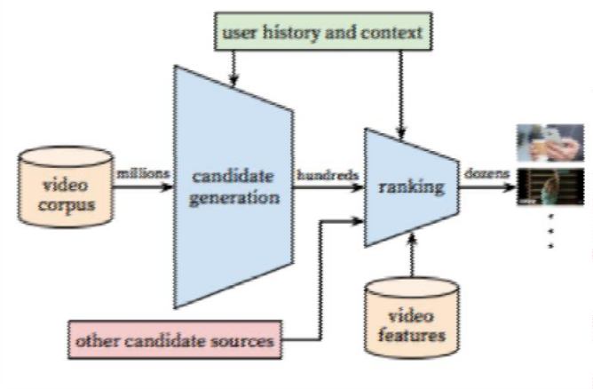
Deep neural networks for youtube recommendations
Challenges:
Sacle
Freshness - constantly growing corpus and non
stationary
Noise
Fig: Recommendation system architecture
Fig: Deep candidate generation model architecture
https://blog.acolyer.org/2016/09/19/deep-neural-networks-for-youtube-recommendations/

Slide 52
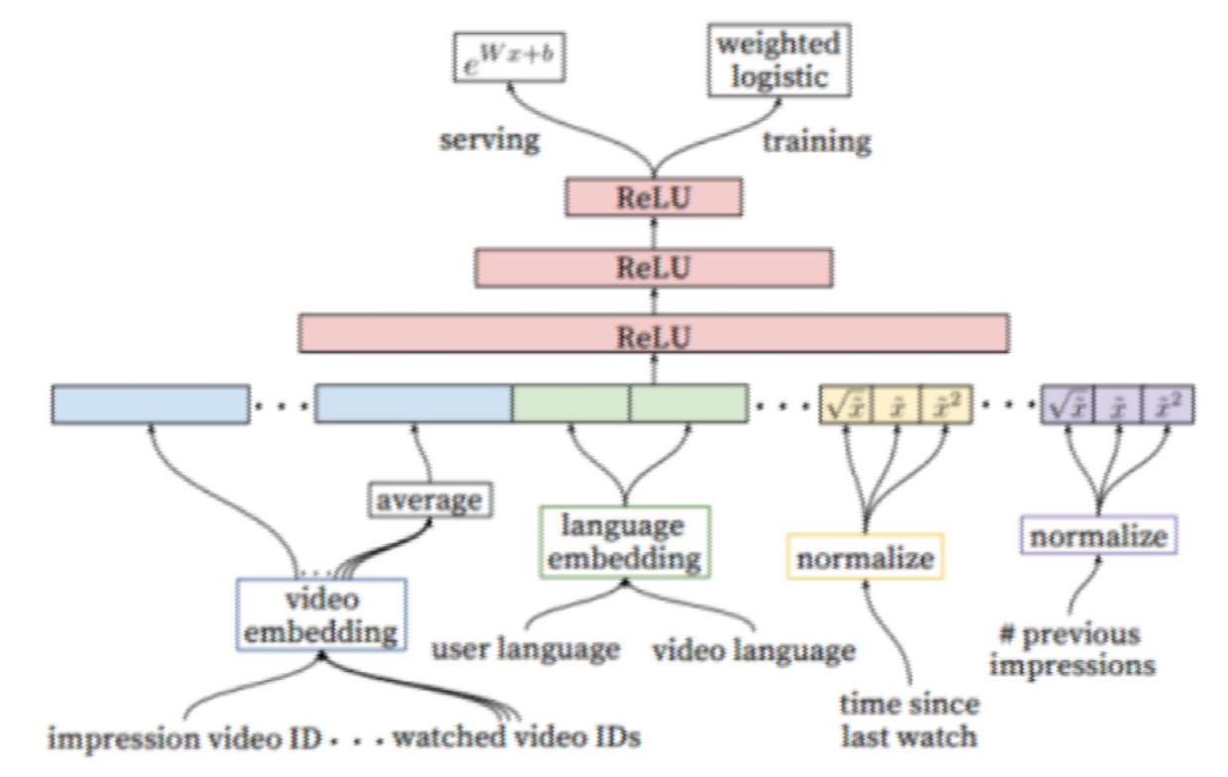
Ranking in youtube recommendations
Embedding:
Multivalent features (watched video
IDs)
Continuous features – normalize
ReLU followed by weighted logistic
Temporal sequence of sparse actions:
Time series of watches,
Likes, searches across devices / contexts

Slide 53
Considerations
Sometimes not recommending or simple recommendation is the best option
Privacy concerns in Recommendation systems
The case of Target Corporation
Computational challenges in recommendation systems, can be costly to implement
•The final model built by winning Netflix team could not be implemented due to engineering challenges
•Good Data Collection, well thought out metrics are a must

Slide 54
Python packages for recommendation systems
Graphlab:
https://www.analyticsvidhya.com/blog/2016/06/quick-guide-build-recommendation-engine-python/
Surprise Lib - Library that provides several of the typical algorithms (SVD++, kNN…) as well as tools for data handling and evaluation http://surpriselib.com/
lightfm - A Python implementation of a hybrid content/collaborative recommender system https://github.com/lyst/lightfm
crab - A more or less complete library of different algorithms. Note though that it hasn’t been updated in a long time https://github.com/python-recsys/crab
http://muricoca.github.io/crab/install.html http://blog.chapagain.com.np/recommender-system-using-python-crab/

Slide 55
Summary
Basics of recommendation system
Popularity based recommendations
Classification model based
Content based recommendations
Nearest neighbour collaborative filtering:
User based
Item based
Hybrid approches
Python examples
Association rule mining
Deep learning based recommendation system

Slide 56
References
http://dataconomy.com/an-introduction-to-recommendation-engines/
https://goo.gl/ehBnhf https://github.com/dvysardana/RecommenderSystems_PyData_2016
https://brenocon.com/blog/2012/03/cosine-similarity-pearson-correlation-and-ols-coefficients/
https://www.analyticsvidhya.com/blog/2016/06/quick-guide-build-recommendation-engine-python/ https://wiki.epfl.ch/edicpublic/documents/Candidacy%20exam/Evaluation.pdf http://www.quuxlabs.com/blog/2010/09/matrix-factorization-a-simple-tutorial-and-implementation-in-python/ http://blog.echen.me/2011/10/24/winning-the-netflix-prize-a-summary/
https://beckernick.github.io/matrix-factorization-recommender/ https://www.kaggle.com/gspmoreira/recommender-systems-in-python-101
Gunawardana, Asela, and Guy Shani. "A survey of accuracy evaluation metrics of recommendation tasks." Journal of Machine Learning Research10.Dec (2009): 2935-2962.
Davis, Jesse, and Mark Goadrich. "The relationship between Precision-Recall and ROC curves." Proceedings of the 23rd international conference on Machine learning. ACM, 2006.

Slide 57
Further reading
Book: Recommender Systems An Introduction by Dietmar Jannach
Book: Mining Massive Datasets by Jure Leskovec, Anand Rajaraman, Jeff Ullman
(www.mmds.org) Video lectures are also available
Coursera course by Andrew Ng
Coursera course on Recommender Systems, by University of Washington Coursera course on Recommender Systems, by University of Minnesota https://dl.acm.org/citation.cfm?doid=2959100.2959166 http://blog.echen.me/2011/10/24/winning-the-netflix-prize-a-summary/

